Slide 1
Macro Processor

Slide 2
Basic Macro Processor functions:
Macro Definition and Expansion
Macro Processor Algorithm and data structures.
Machine-independent Macro Processor features: Concatenation of Macro Parameters
Generation of Unique Labels
Conditional Macro Expansion
Keyword Macro Parameters
Macro Processor Design Options
Recursive Macro Expansion
General Purpose Macro Processors
Macro Processing within Language Translators
Implementation examples:
MASM Macro Processor – ANSI C Macro language.

Slide 3
Macro Processor
Recognize macro definitions
Save the macro definition
Recognize macro calls
Expand macro calls
Source Code
(with macro)
Macro Processor
Expanded Code
Compiler or Assembler
obj

Slide 4
Copy code -- Example
Source
STRG MACRO
STA DATA1
STB DATA2
STX DATA3
MEND
.
STRG
.
STRG
.
.
Expanded source
.
.
.
STA DATA1
STB DATA2
STX DATA3
.
STA DATA1
STB DATA2
STX DATA3
.
{
{

Slide 5
Macro vs. Subroutine
Macro
the statement of expansion are generated each time the macro are invoked
Subroutine
the statement in a subroutine appears only once

Slide 6
Parameter Substitution -- Example
Source
STRG MACRO &a1, &a2, &a3
STA &a1
STB &a2
STX &a3
MEND
.
STRG DATA1, DATA2, DATA3
.
STRG DATA4, DATA5, DATA6
.
.
Expanded souce
.
.
.
STA DATA1
STB DATA2
STX DATA3
.
STA DATA4
STB DATA5
STX DATA6
.
{
{

Slide 7
Macro Instruction
A macro instruction (macro) is simply a notational convenience for the programmer.
A macro represents a commonly used group of statements in the source program.
The macro processor replaces each macro instruction with the corresponding group of source statements.
This operation is called “expanding the macro”
Using macros allows a programmer to write a shorthand version of a program.
For example, before calling a subroutine, the contents of all registers may need to be stored. This routine work can be done using a macro.

Slide 8
Machine Independent
The functions of a macro processor essentially involve the substitution of one group of lines for another. Normally, the processor performs no analysis of the text it handles.
The meaning of these statements are of no concern during macro expansion.
Therefore, the design of a macro processor generally is machine independent.
Macro mostly are used un assembler language programming. However, it can also be used in high-level programming languages such as C or C++.

Slide 9
Basic Functions
Macro definition
The two directive MACRO and MEND are used in macro definition.
The macro’s name appears before the MACRO directive.
The macro’s parameters appear after the MACRO directive.
Each parameter begins with ‘&’
Between MACRO and MEND is the body of the macro. These are the statements that will be generated as the expansion of the macro definition.

Slide 10
Basic Functions
Macro expansion (or invocation)
Give the name of the macro to be expanded and the arguments to be used in expanding the macro.
Each macro invocation statement will be expanded into the statements that form the body of the macro, with arguments from the macro invocation substituted for the parameters in the macro prototype.
The arguments and parameters are associated with one another according to their positions.
The first argument corresponds to the first parameter, and so on.

Slide 11
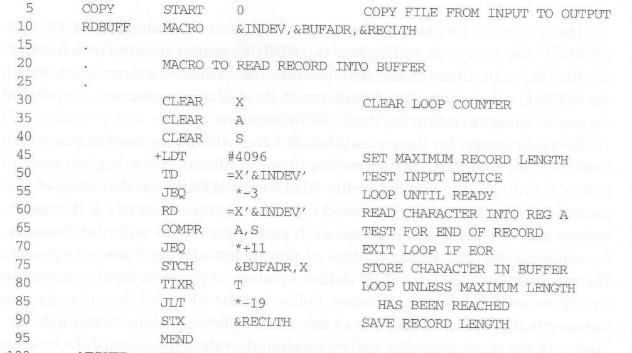
Macro Program Example
Macro definition
Avoid the use of labels in a macro

Slide 12
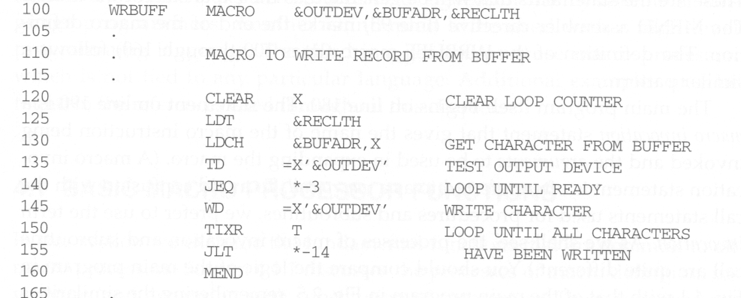
Macro definition
Avoid the use of labels in a macro

Slide 13
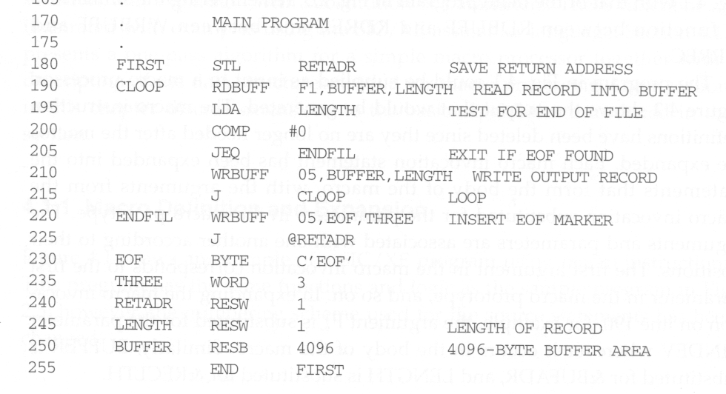
Macro invocations

Slide 14
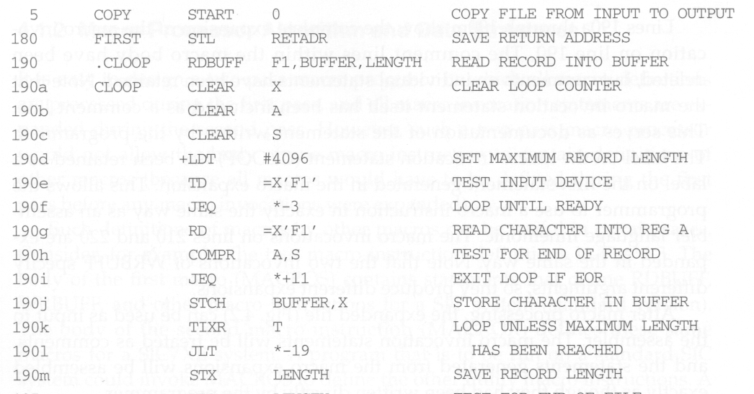
Expanded Macro Program

Slide 15
Retain Labels on Expanded Macro
The label on the macro invocation statement CLOOP has been retained as a label on the first statement generated in the macro expansion.
This allows the programmer to use a macro instruction in exactly the same way as an assembler language mnemonic.

Slide 16
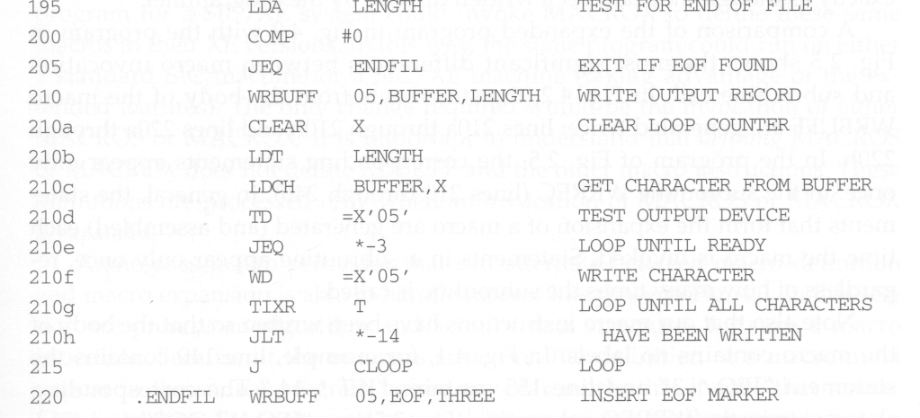

Slide 17
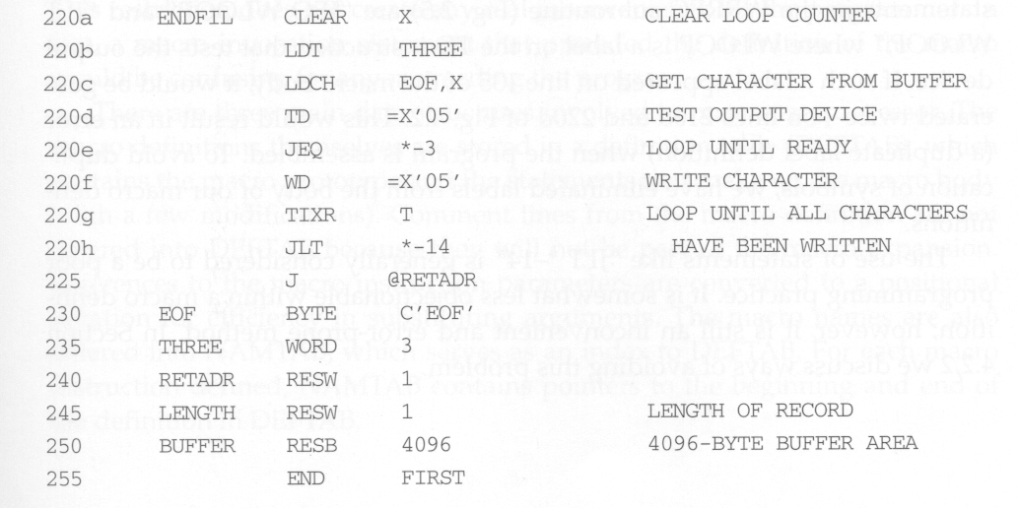

Slide 18
Differences between Macro and Subroutine
After macro processing, the expanded file can be used as input to the assembler.
The statements generated from the macro expansions will be assembled exactly as though they had been written directly by the programmer.
The differences between macro invocation and subroutine call
The statements that form the body of the macro are generated each time a macro is expanded.
Statements in a subroutine appear only once, regardless of how many times the subroutine is called.

Slide 19
Avoid Uses of Labels in Macro
In RDBUFF and WRBUFF macros, many program-counter relative addressing instructions are used to avoid the uses of labels in a macro.
For example, JLT * - 19
This is to avoid generating duplicate labels when the same macro is expanded multiple time at different places in the program. (will be treated as error by the assembler)
Later on, we will present a method which allows a programmer to use labels in a macro definition.

Slide 20
Two-Pass Macro Processor
Like an assembler or a loader, we can design a two-pass macro processor in which all macro definitions are processed during the first pass, and all macro invocation statements are expanded during the second pass.
However, such a macro processor cannot allow the body of one macro instruction to contain definitions of other macros.
Because all macros would have to be defined during the first pass before any macro invocations were expanded.

Slide 21
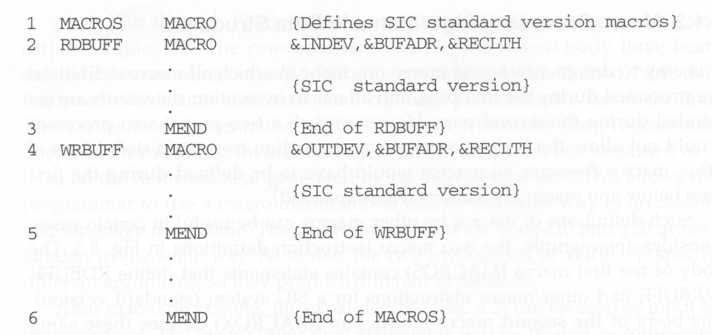
Macro Containing Macro Example

Slide 22
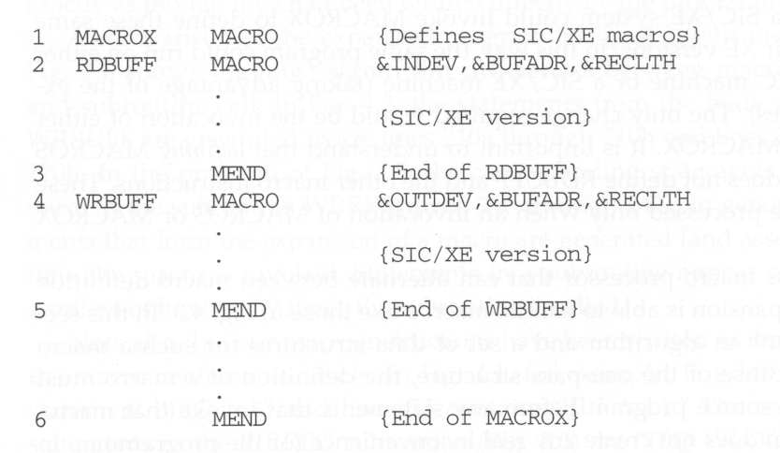

Slide 23
Macro Containing Macro Example
MACROS contains the definitions of RDBUFF and WRBUFF which are written in SIC instructions.
MACROX contains the definitions of RDBUFF and WRBUFF which are written in SIC/XE instructions.
A program that is to be run on SIC system could invoke MACROS whereas a program to be run on SIC/XE can invoke MACROX.
Defining MACROS or MACROX does not define RDBUFF and WRBUFF. These definitions are processed only when an invocation of MACROS or MACROX is expanded.

Slide 24
One-Pass Macro Processor
A one-pass macro processor that alternate between macro definition and macro expansion is able to handle “macro in macro”.
However, because of the one-pass structure, the definition of a macro must appear in the source program before any statements that invoke that macro.
This restriction is reasonable.

Slide 25
Data Structures
DEFTAB
Store the definition statements of macros
Comment lines are omitted.
References to the macro instruction parameters are converted to a positional notation for efficiency in substituting arguments.
NAMTAB
Store macro names, which serves an index to DEFTAB
Contain pointers to the beginning and end of the definition
ARGTAB
Used during the expansion of macro invocations.
When a macro invocation statement is encountered, the arguments are stored in this table according to their position in the argument list.

Slide 26
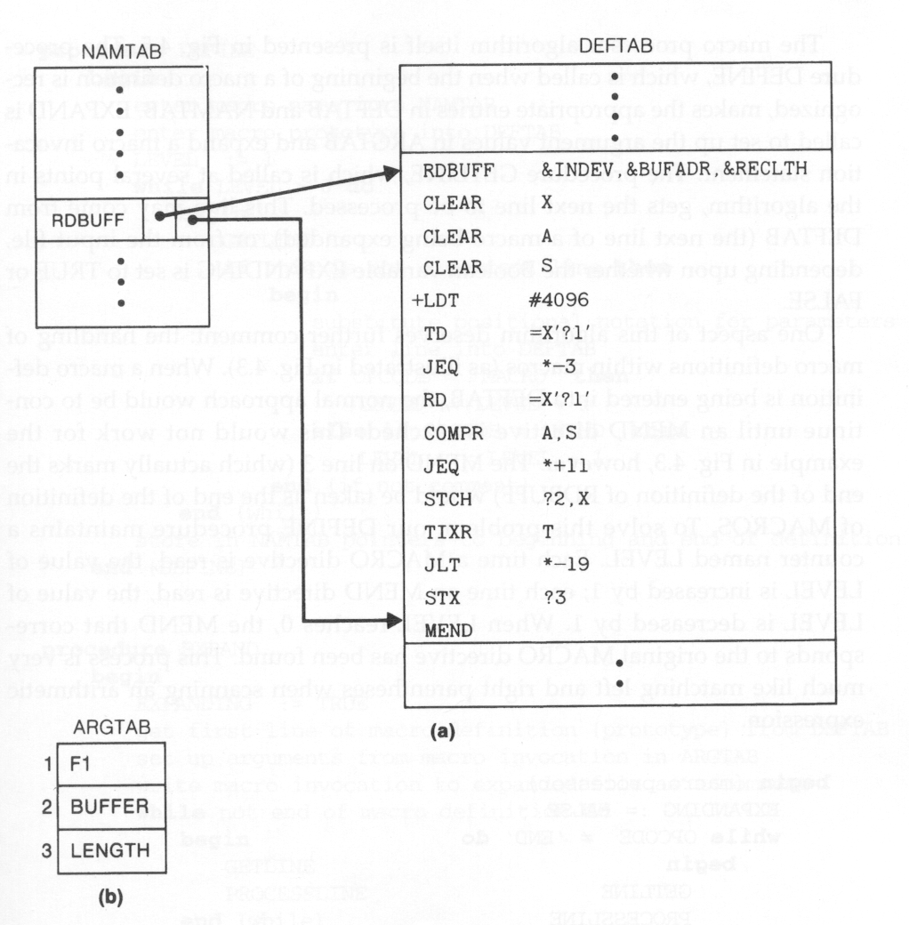
Data Structures Snapshot

Slide 27
Algorithm
Procedure DEFINE
Called when the beginning of a macro definition is recognized. Make appropriate entries in DEFTAB and NAMTAB.
Procedure EXPAND
Called to set up the argument values in ARGTAB and expand a macro invocation statement
Procedure GETLINE
Get the next line to be processed

Slide 28
Handle Macro in Macro
When a macro definition is being entered into DEFTAB, the normal approach is to continue until an MEND directive is reached.
This will not work for “macro in macro” because the MEND first encountered (for the inner macro) will prematurely end the definition of the outer macro.
To solve this problem, a counter LEVEL is used to keep track of the level of macro definitions. A MEND will end the definition of the macro currently being processed only when LEVEL is 0.
This is very much like matching left and right parentheses when scanning an arithmetic expression.

Slide 29
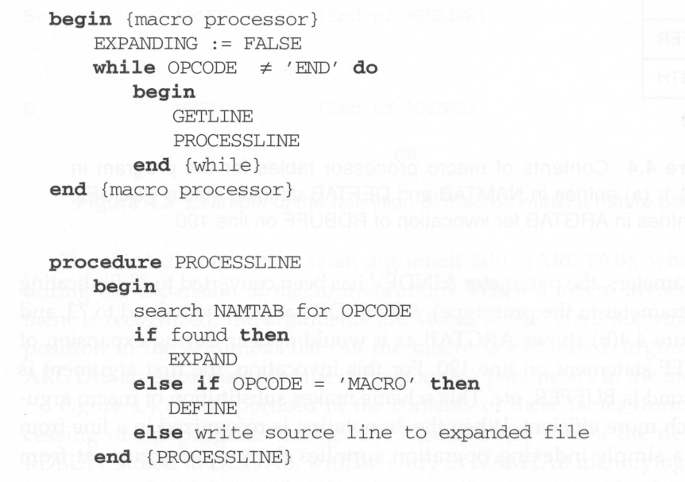
Algorithm Pseudo Code

Slide 30
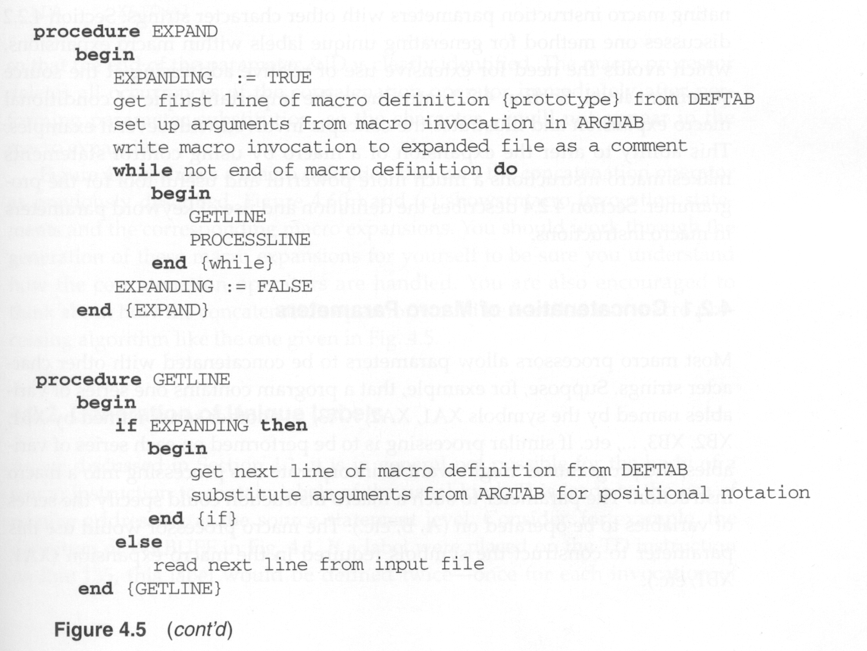

Slide 31
DEFINE (line)
{
enter line.label into NAMTAB; /* enter macro name into NAMTAB */
enter macro prototype into DEFTAB; /* the first declaration statement */
LEVEL = 1;
while (LEVEL > 0) {
GETLINE (line); /* get the next line of the macro definition */
if (line != comment line) {
substitute positional notation for parameters; /* &param_1 ➔ ?1, etc. */
enter line into DEFTAB;
if (OPCODE = ‘MACRO’)
LEVEL = LEVEL +1;
else if (OPCODE = ‘MEND’)
LEVEL = LEVEL –1;
}
}
store pointers (label->begin and label->end) in NAMTAB; /* store macro def. begin and end pointers */
}

Slide 32
1-Pass Macro Processor

Slide 33
Machine Independent Features

Slide 34
Concatenation of Macro Parameters
Most macro processors allow parameters to be concatenated with other character stings.
E.g., to flexibly and easily generate the variables XA1, XA2, XA3, …, or XB1, XB2, XB3, “A” or “B” can be input as an argument. We just need to concatenate “X”, the argument, and the “1” , “2”, “3” .. together.

Slide 35
Concatenation Problem
Suppose that the parameter to such a macro instruction is named &ID, the body of the macro definition may contain a statement like LDA X&ID1, in which &ID is concatenated after the string “X” and before the string “1”.
The problem is that the end of the parameter is not marked. Thus X&ID1 may mean “X” + ID + “1” or “X” + ID1.
To avoid this ambiguity, a special concatenation operator -> is used. The new form becomes X&ID->1. Of course, -> will not appear in the macro expansion.

Slide 36
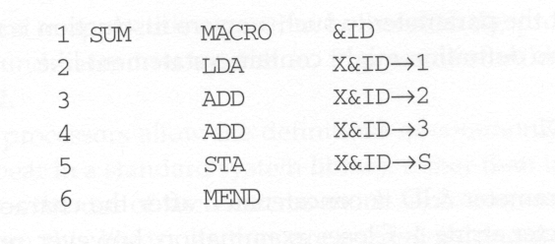
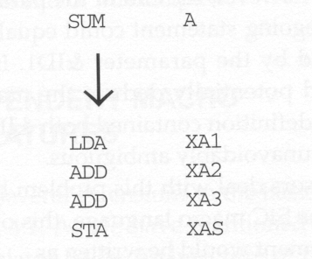
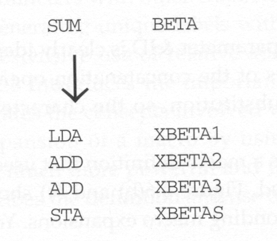
Concatenation Example

Slide 37
Generation of Unique Labels
Previously we see that, without special processing, if labels are used in macro definition, we may encounter the “duplicate labels” problem if a macro is invocated multiple time.
To generate unique labels for each macro invocation, when writing macro definition, we must begin a label with $.
During macro expansion, the $ will be replaced with $xx, where xx is a two-character alphanumeric counter of the number of macro instructions expanded.
XX will start from AA, AB, AC,…..

Slide 38
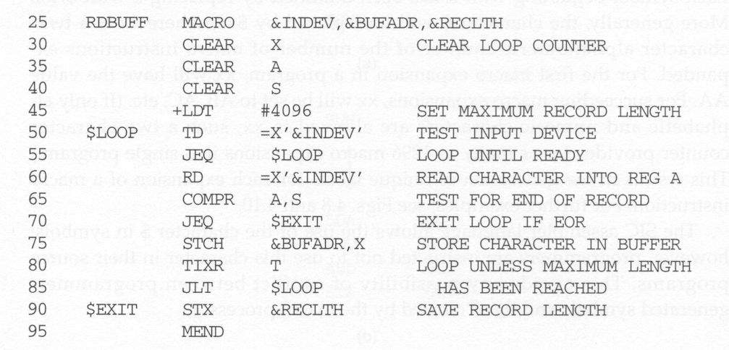
Unique Labels Macro Definition

Slide 39
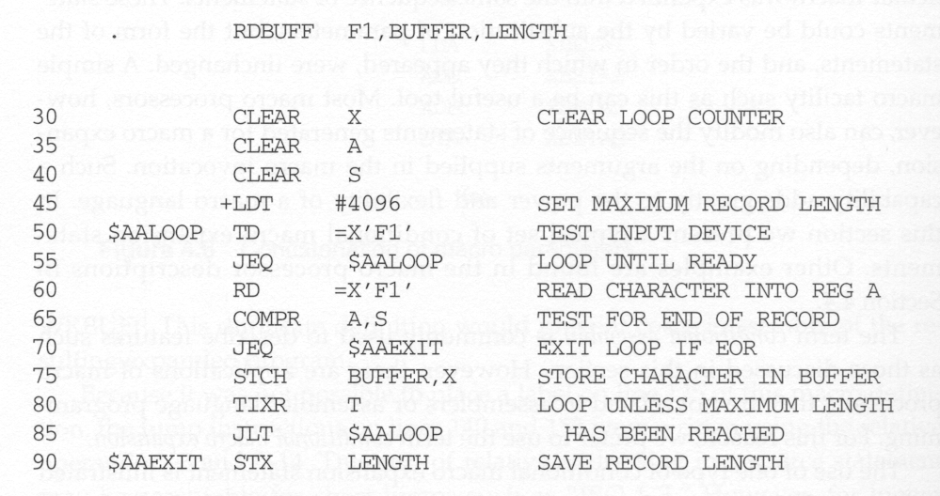
Unique Labels Macro Expansion

Slide 40
Conditional Macro Expansion
So far, when a macro instruction is invoked, the same sequence of statements are used to expand the macro.
Here, we allow conditional assembly to be used.
Depending on the arguments supplied in the macro invocation, the sequence of statements generated for a macro expansion can be modified.
Conditional macro expansion can be very useful. It can generate code that is suitable for a particular application.

Slide 41
Conditional Macro Example
In the following example, the values of &EOR and &MAXLTH parameters are used to determine which parts of a macro definition need to be generated.
There are some macro-time control structures introduced for doing conditional macro expansion:
IF- ELSE-ENDIF
WHILE-ENDW
Macro-time variables can also be used to store values that are used by these macro-time control structures.
Used to store the boolean expression evaluation result
A variable that starts with & but not defined in the parameter list is treated as a macro-time variable.

Slide 42
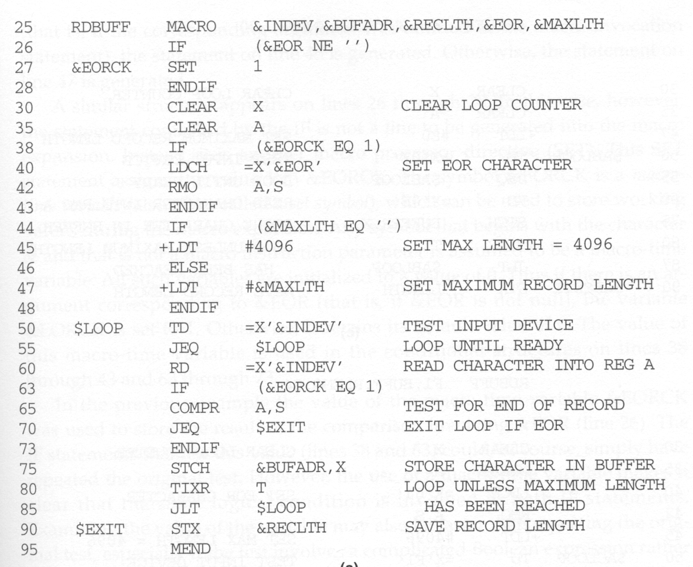
Macro time variable
Conditional macro control structure

Slide 43
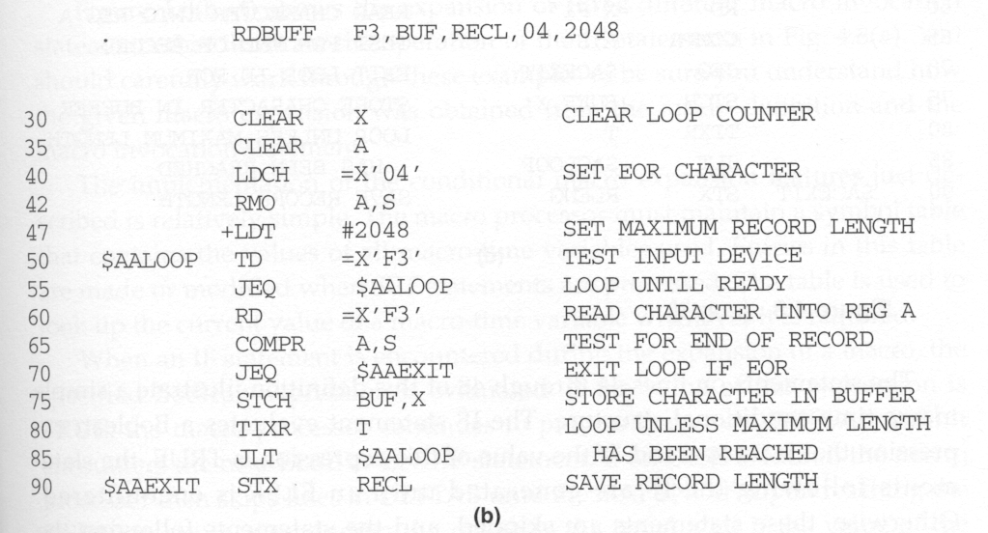
Conditional macro expansion 1

Slide 44
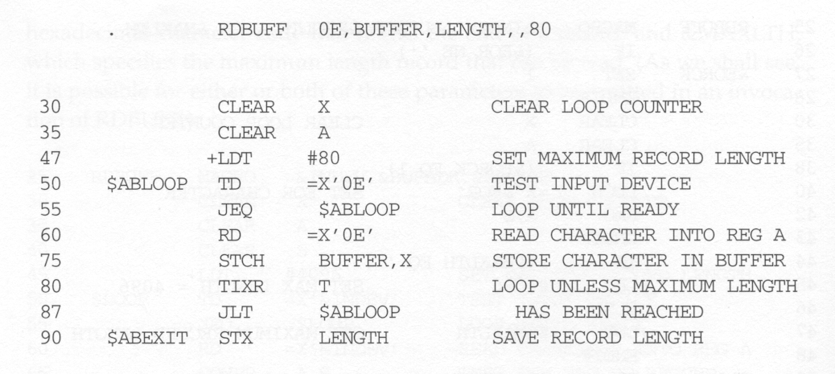
Conditional macro expansion 2

Slide 45
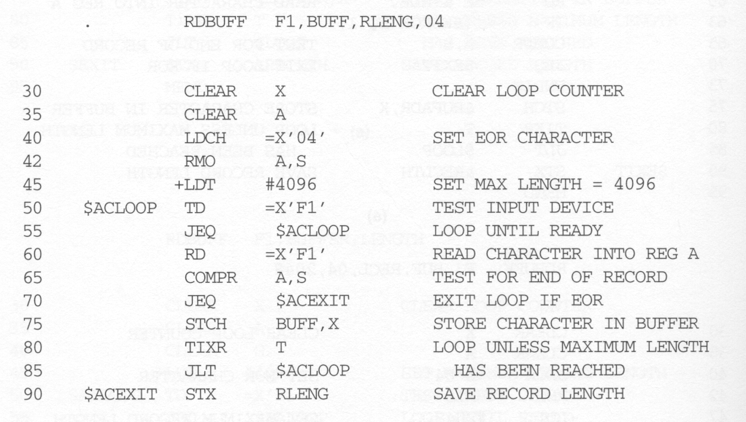
Conditional macro expansion 3

Slide 46
Conditional Macro Implementation
The assembler maintains a symbol table that contains the values of all macro-time variables used.
Entries in this table are made or modified when SET statements are processed.
When an IF statement is encountered during the expansion of a macro, the specified boolean expression is evaluated.
If the value of this expression is TRUE, the macro processor continues to process until it encounters the next ELSE or ENDIF.
If ELSE is encountered, then skips to ENDIF
Otherwise, the assembler skips to ELSE and continues to process until it reaches ENDIF.

Slide 47
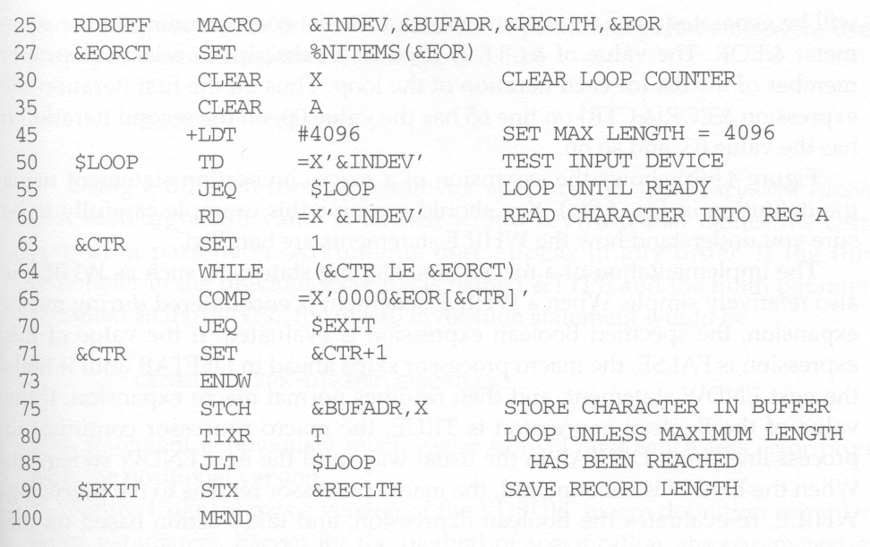
Conditional Macro Example
Macro processor function

Slide 48
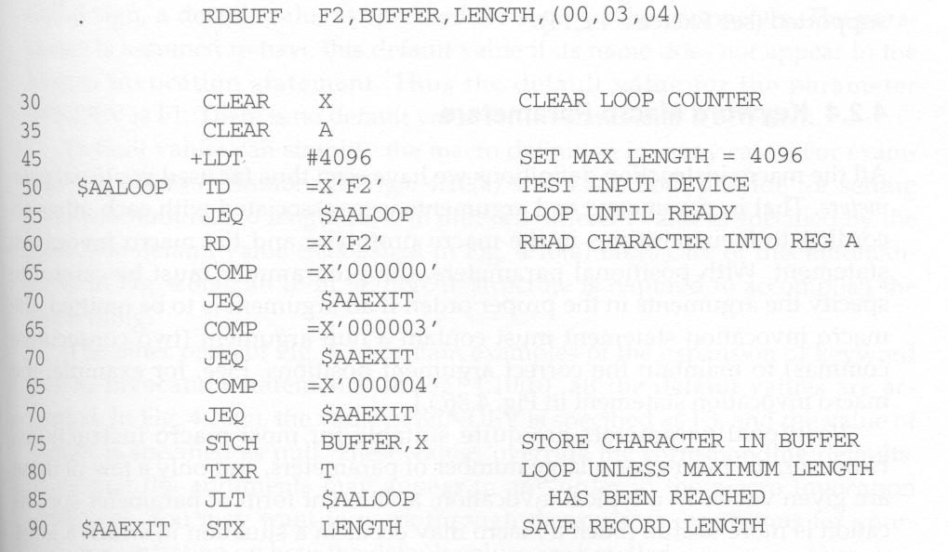

Slide 49
Conditional Macro Expansion v.s. Conditional Jump Instructions
The testing of Boolean expression in IF statements occurs at the time macros are expanded.
By the time the program is assembled, all such decisions have been made.
There is only one sequence of source statements during program execution.
In contrast, the COMPR instruction test data values during program execution. The sequence of statements that are executed during program execution may be different in different program executions.

Slide 50
Keyword Macro Parameters
So far, all macro instructions use positional parameters.
If an argument is to be omitted, the macro invocation statement must contain a null argument to maintain the correct argument positions.
E.g., GENER ,,DIRECT,,,,,,3.
If keyword parameters are used, each argument value is written with a keyword that names the corresponding parameters.
Arguments thus can appear in any order.
Null arguments no longer need to be used.
E.g., GENER TYPE=DIRECT, CHANNEL=3
Keyword parameter method can make a program easier to read than the positional method.

Slide 51
4.2.4 Keyword Macro Parameters
Positional parameters
Parameters and arguments were associated with each other according to their positions in the macro prototype and the macro invocation statements.
A certain macro instruction GENER has 10 possible parameters.
GENER MACRO &1, &2, &type, …, &channel, &10
GENER , , DIRECT, , , , , , 3

Slide 52
4.2.4 Keyword Macro Parameters
Keyword parameters
Each argument value is written with a keyword that names the corresponding parameter.
Arguments may appear in any order.
GENER MACRO &1, &2, &type, …, &channel, &10
GENER , , DIRECT, , , , , , 3 (positional)
GENER TYPE=DIRECT, CHANNEL=3 (keyword)
GENER CHANNEL=3, TYPE=DIRECT (keyword)
parameter=argument

Slide 53
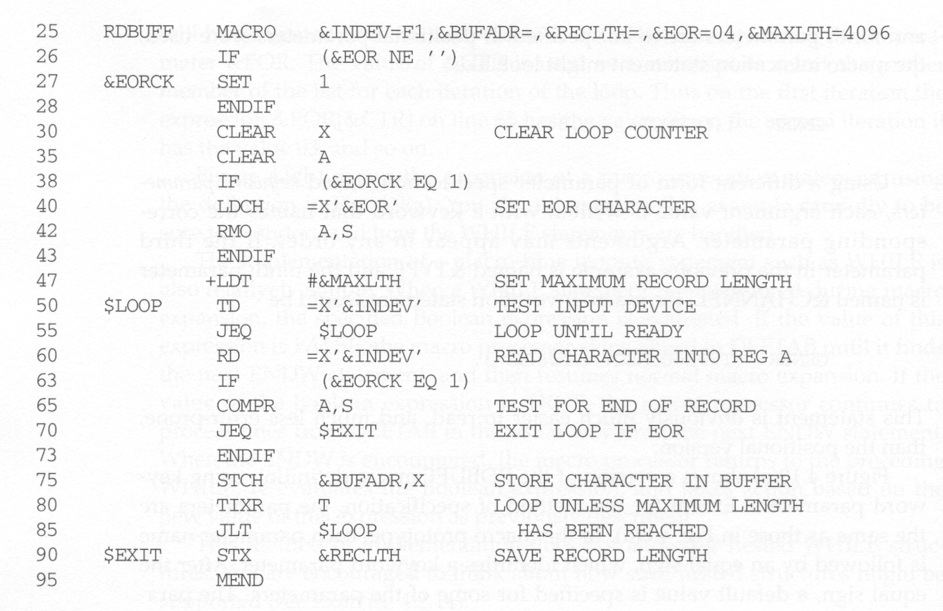
Keyword Macro Example
Can specify default values

Slide 54
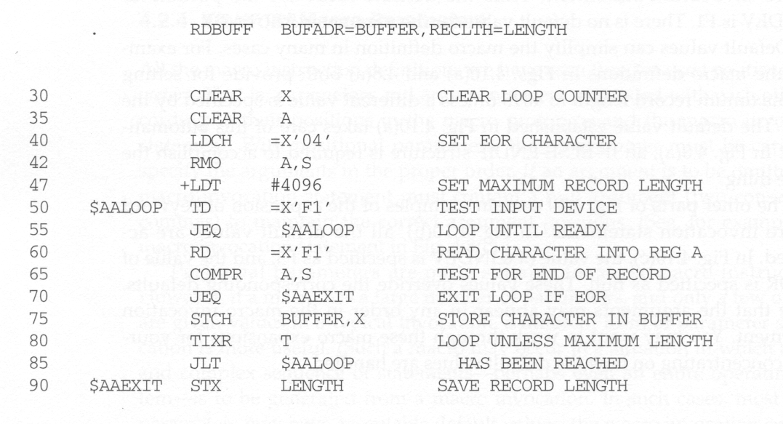
Keyword parameters

Slide 55
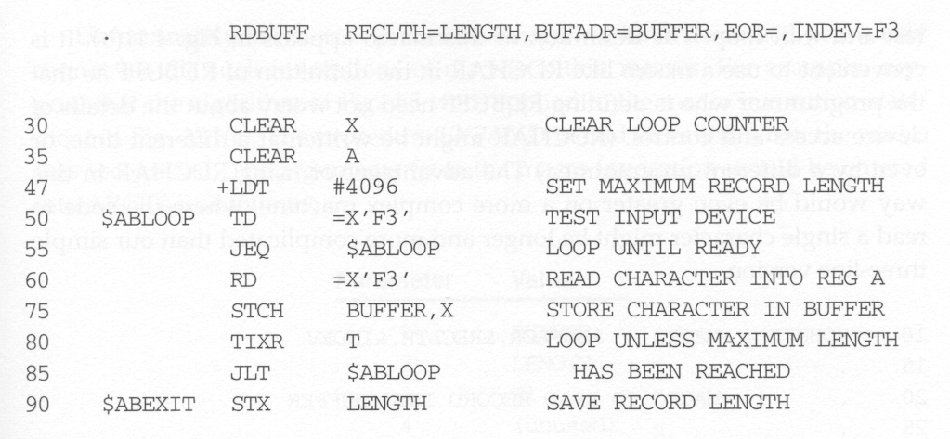

Slide 56
Macro Processor Design Options
Recursive Macro expression
General-Purpose Macro Processors
Macro Processing within Language Translators

Slide 57
Recursive Macro Expansion
Macro within macro can be solved if the macro processor is being written in a programming language that allows recursive calls
The compiler would be sure that previous value of any variables declared within a procedure were saved when that procedure was called recursively
If would take care of other details involving return from the procedure

Slide 58
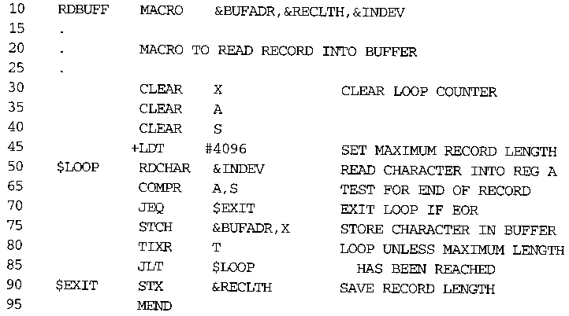
Example of Nested Macro Invocation(2/1)

Slide 59
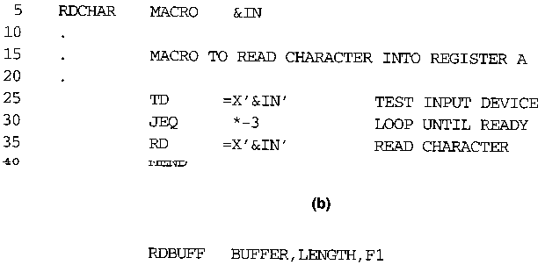
Example of Nested Macro Invocation(2/2)

Slide 60
Macro Processor Design Options
Recursive Macro Expansion
Problems with previous macro processor
- when a macro invokes another macro
ARGTAB is overwritten
- when the second macro finishes
EXPANDING is set to FALSE

Slide 61
Solution
- if macro processor is written in a high-level
language that supports recursion, then there
won't be problems since the compiler saves the
previous values of variables on recursive calls
- if macro processor must be written in a
programming language that does not support
recursion, then the system programmer must
save the data values (this can be done using a
stack)

Slide 62
General-Purpose Macro Processors
A general purpose macro processor is a macro processor that is not tied to any particular language.
Macro processors that do not dependent on any particular programming language, but can be used with a variety of different languages

Slide 63
General-Purpose Macro Processors(2/1)
Advantages of general-purpose macro processors:
The programmer does not need to learn about a different macro facility for each compiler or assembler.
Over all software development cost can be reduced

Slide 64
General-Purpose Macro Processors(2/2)
Comments should usually be ignored by a macro processor, however, each programming language has its own methods for identifying comments
Each programming language has different facilities for grouping terms, expressions, or statements—a general-purpose macro processor needs to taking these grouping into account
Languages differ substantially in their restrictions on the length of identifiers and the rules for the formation of constants
Programming languages have different basic statement forms—syntax used for macro definitions and macro invocation statements

Slide 65
Macro Processing within Language Translators(2/1)
The macro processor reads the source statements and performs all of its functions, the output lines are passed to the language translator as they are generated
The macro processor operates as a sort of input routine for the assembler or compiler
The line-by-line approach avoids making an extra pass over the source program, so it can be more efficient than using a macro preprocessor
Some of the data structures required by the macro processor and the language translator can be combined
A line-by-line macro processor also makes it easier to give diagnostic messages that are related to the source statement containing the error

Slide 66
Macro Processing within Language Translators(2/2)
An integrated macro processor can potentially make use of any information about the source program that is extracted by the language translator
An integrated macro processor can support macro instructions that depend upon the context in which they occur
Line-by-line macro processors must be specially designed and written to work with a particular implementation of an assembler or compiler, which results in a more expensive piece of software
The assembler or compiler will be considerably larger and more complex than it would be
The additional complexity will add to the overhead of language translation

Slide 67
MASM Macro Processor(2/1)
The macro processor of MASM is integrated with Pass 1 of the assembler
MASM generates the unique names of local labels in the form ??n, where n is a hexadecimal number in the range 0000 to FFFF
.ERR: signals to MASM that an error has been detected
EXITM: directs MASM to terminate the expansion of the macro
&: is a concatenation operator

Slide 68
MASM Macro Processor(2/2)
;; is a macro comment, serves only as documentation for the macro definition
; is an ordinary assembler language comment, included as part of the macro expansion
IRP: sets the macro-time variable to a sequence of values specified in <…>
The statements between the TRP and the matching ENDM are generated once for each value of the variable

Slide 69
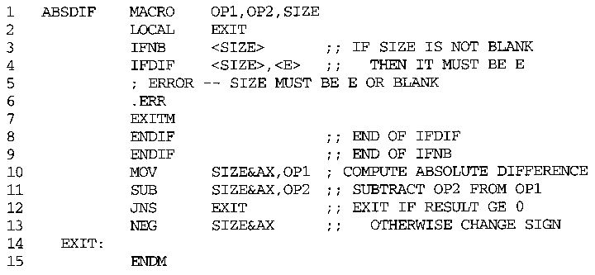
Examples of MASM Macro and Conditional Statements(3/1)

Slide 70
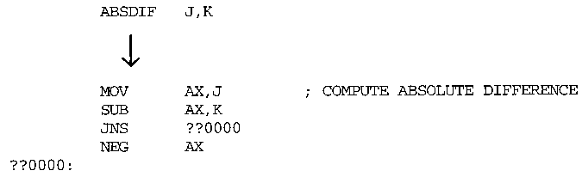
Examples of MASM Macro and Conditional Statements(3/2)

Slide 71
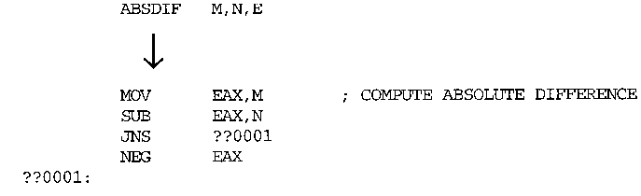
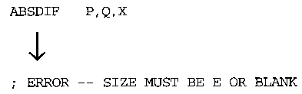
Examples of MASM Macro and Conditional Statements(3/3)

Slide 72
ANSI C Macro Language
In the ANSI C language, definitions and invocations of macros are handled by a preprocessor, which is generally not integrated with the rest of the compiler.
Two simple example of ANSI C macro definition
#define NULL 0
#define EOF -1
Defining Macro
#define EQ = = ->syntactic modification
Programmer could write as
While (I EQ 0)
Macro processor convert this into
While(I = = 0)

Slide 73
ANSI C Macro Language
ANSI C macros defined with parameters
#define ABSDIFF (X,Y) ( (X)>(Y) ? (X)-(Y) : (Y)-(X) )

Slide 74
ANSI C Macro Language
Conditional compilation statements
Example 1:
#ifndef BUFFER_SIZE
#define BUFFER_SIZE 1024
#endif

Slide 75
Expand the following macro invocation statements, using the macro invocation and definition given below.
RDBUFF F3, BUF, LEN, (01, 04, 09)
RDBUFF F1, BUFFER, LENGTH
RDBUFF MACRO &INDEV,&BUFADR,&RECLTH,&EOR
&EORCT SET %NITEMS(&EOR)
CLEAR X
CLEAR A
+LDT #4096
$LOOP TD =X’&INDEV’
JEQ $LOOP
RD =X’&INDEV’
&CTR SET 1
WHILE (&CTR LE &EORCT)
COMP =X’0000&EOR(&CTR)
JEQ $EXIT
&CTR SET &CTR+1
ENDW
STCH &BUFADR,X
TIXR T
JLT $LOOP
$EXIT STX &RECLTH
MEND

